Slide 1


Water Quality Classification
CIND820:
Big Data Analytics Project
Project by: Ann Sam ann.sam@ryerson.ca Student #501160843
Supervisor: Dr. Ceni Baboglu
Spring-Summer 2022

Slide 2
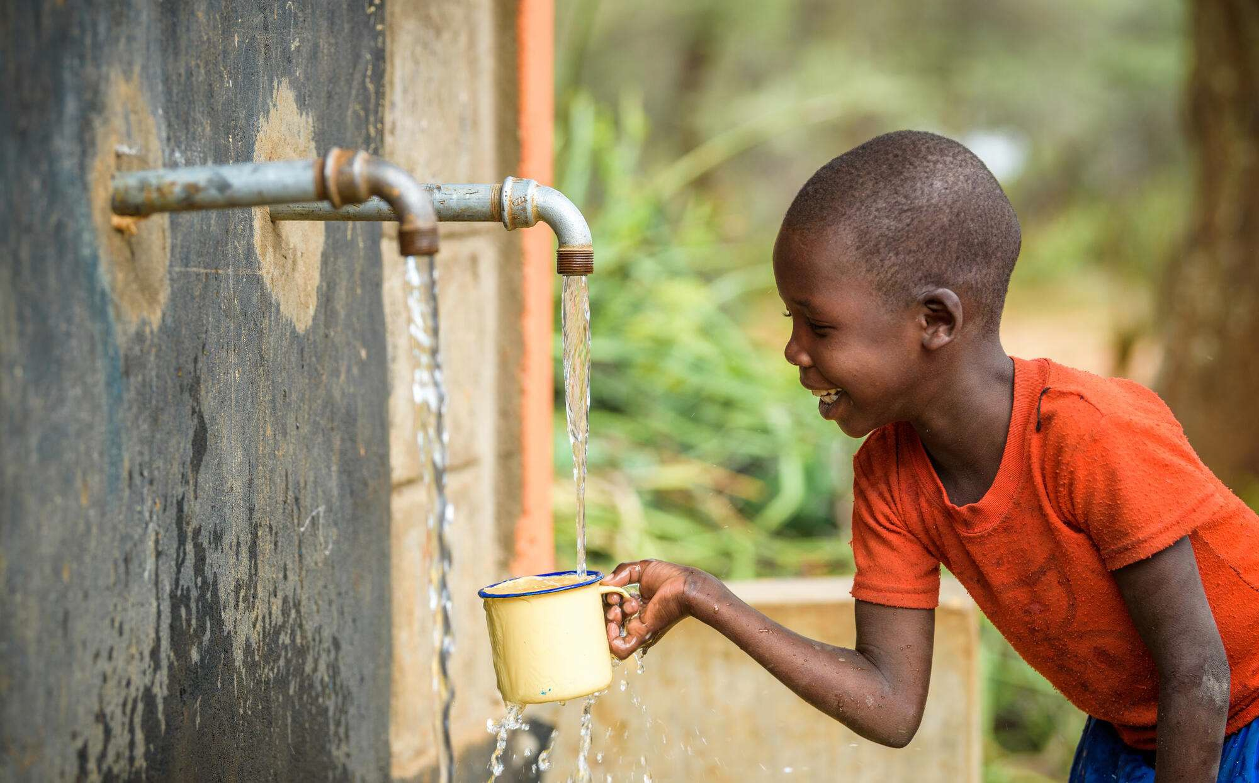
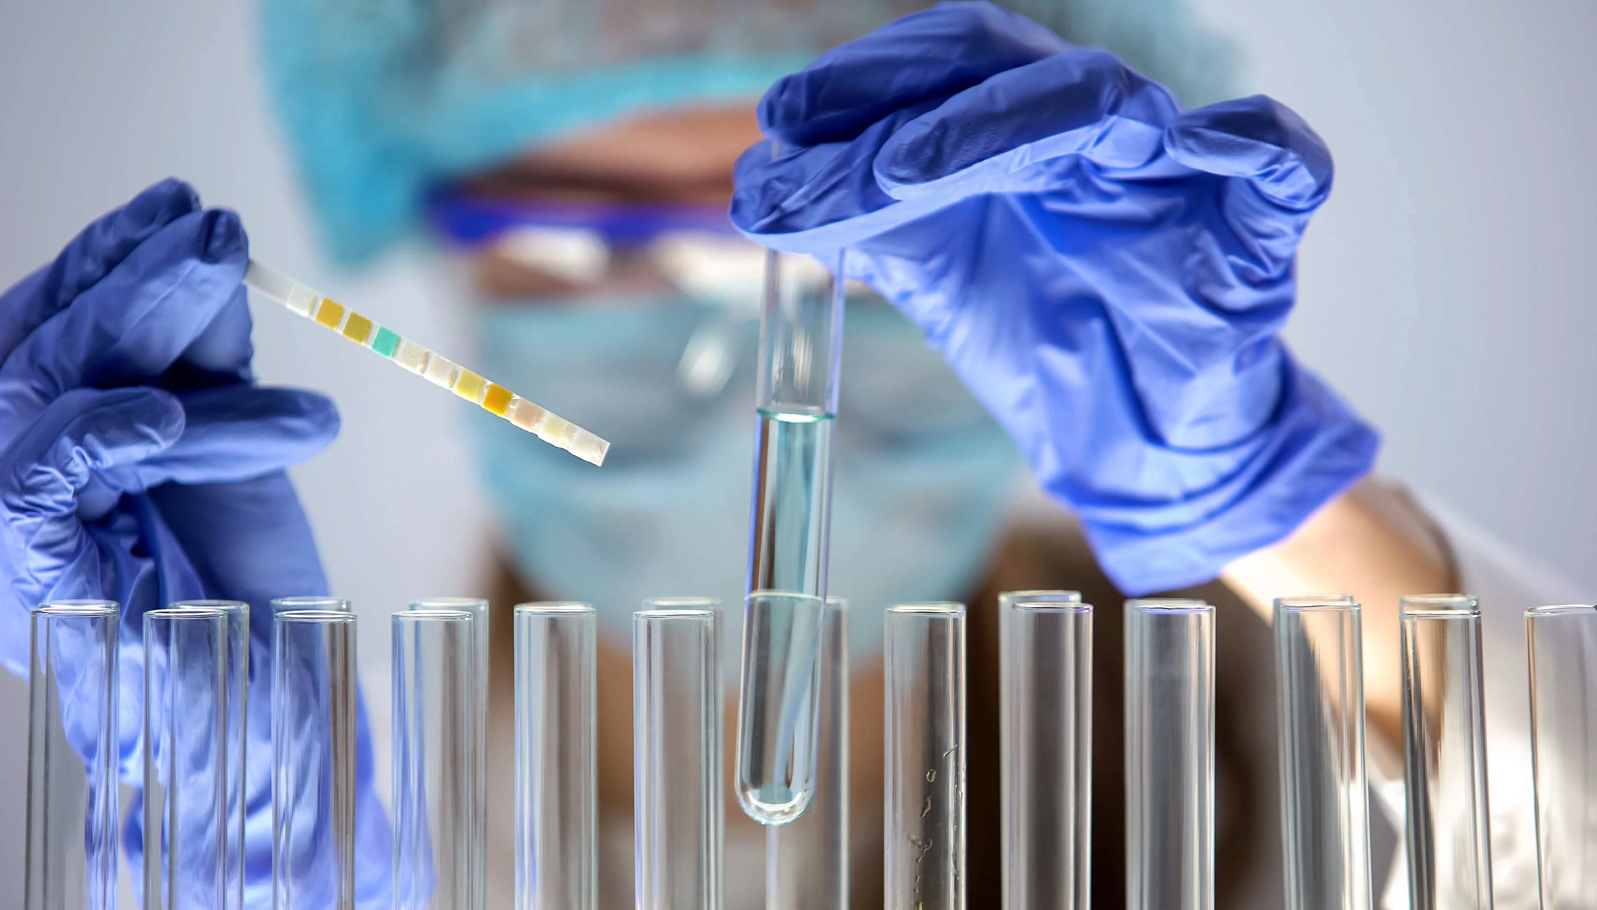
Why classify water?
Basic necessity for all human life
Process of water testing is time consuming: water collection and laboratory testing
Costly
Can machine learning improve the process of water classification?

Slide 3
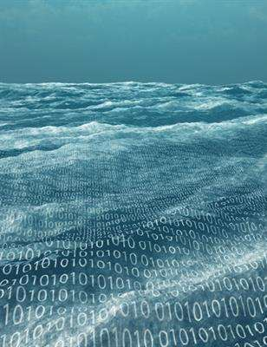
Predicting Water Potability
Can we predict water potability?
Which machine learning algorithms can yield the most efficient and accurate results?
Can the parameters within the ML algorithms be tuned to yield the best results?
Are the parameters within the dataset affective in water quality prediction?
Should there be other parameters to consider?
How confident are we in our findings?

Slide 4















The Dataset
https://www.kaggle.com/datasets/adityakadiwal/water-potability/
pH
Turbidity
Hardness
9 Parameters
3276 Records
Trihalomethanes
Solids
Potability
Binary Target Variable
Organic Carbon
Chloramines
Conductivity
Sulfates

Slide 5







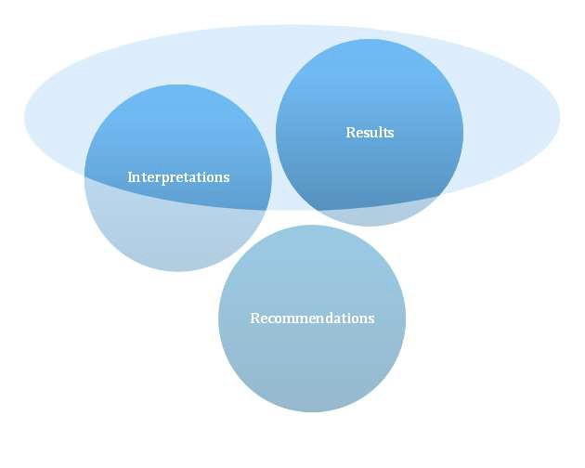










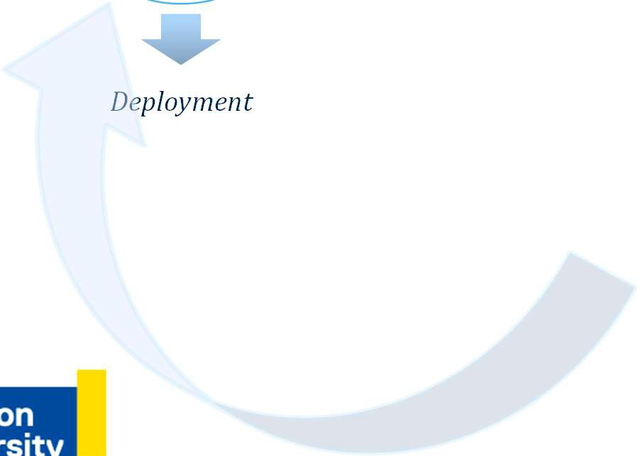











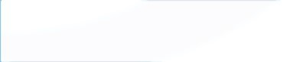
Approach Process
Data Cleaning
Outlier Detection
EDA
Data Processing
RReessuullttss
IInntteerrpprreettaattiioonnss
RReeccoommmmeennddaattiioonnss
Logistic Regression
KNN
Model Training
Decision Tree
Random Forest SVM
XGBoost
Conclusions
Deployment
Model Evaluation
.
Algorithm Comparison
.
Hyper-tuning
.
Cross Validation
5

Slide 6
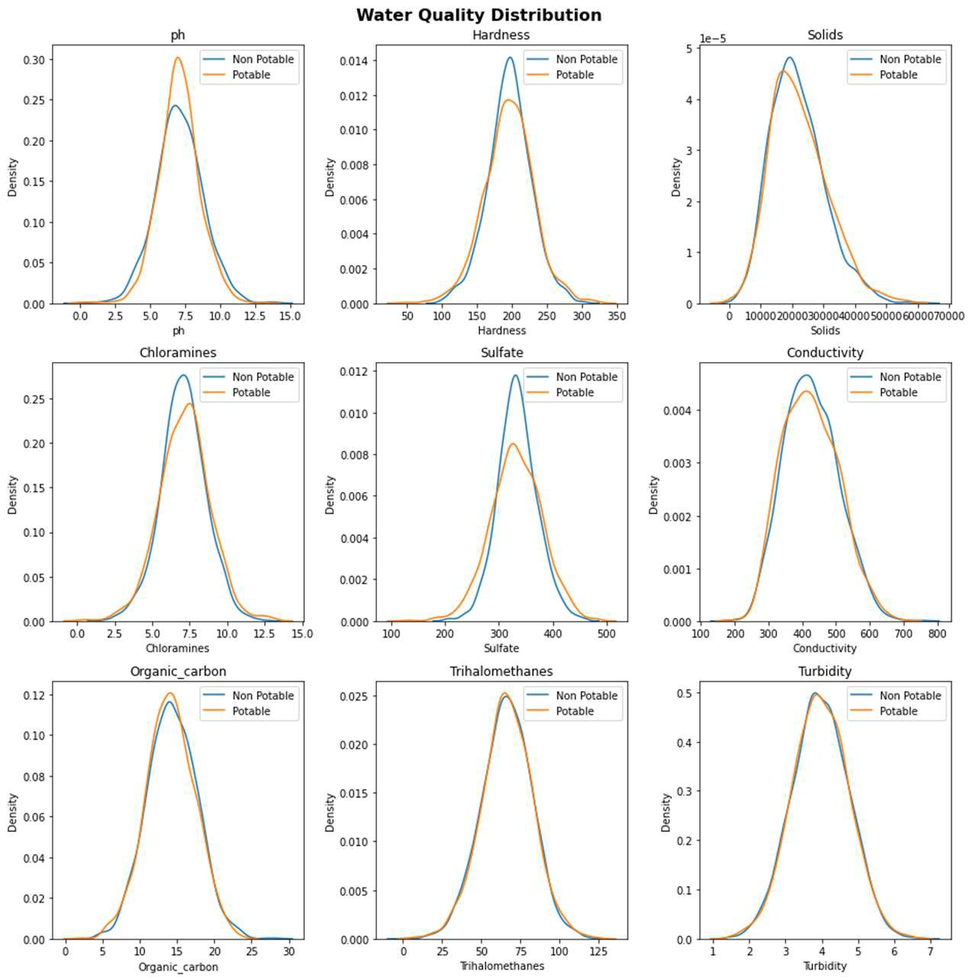
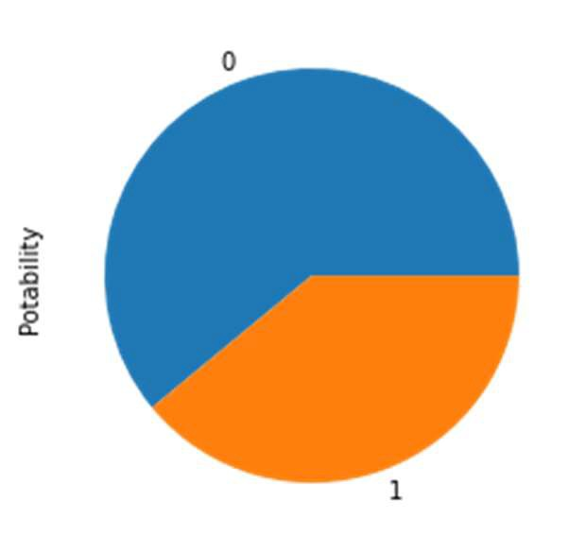
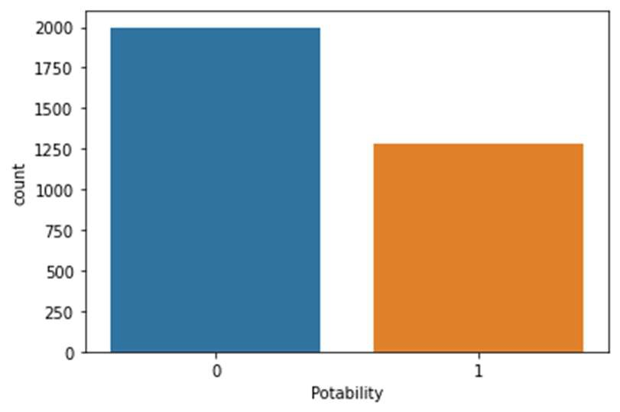
EDA: Visual Analyses
Non-Potable
Potable
1998
1278

Slide 7
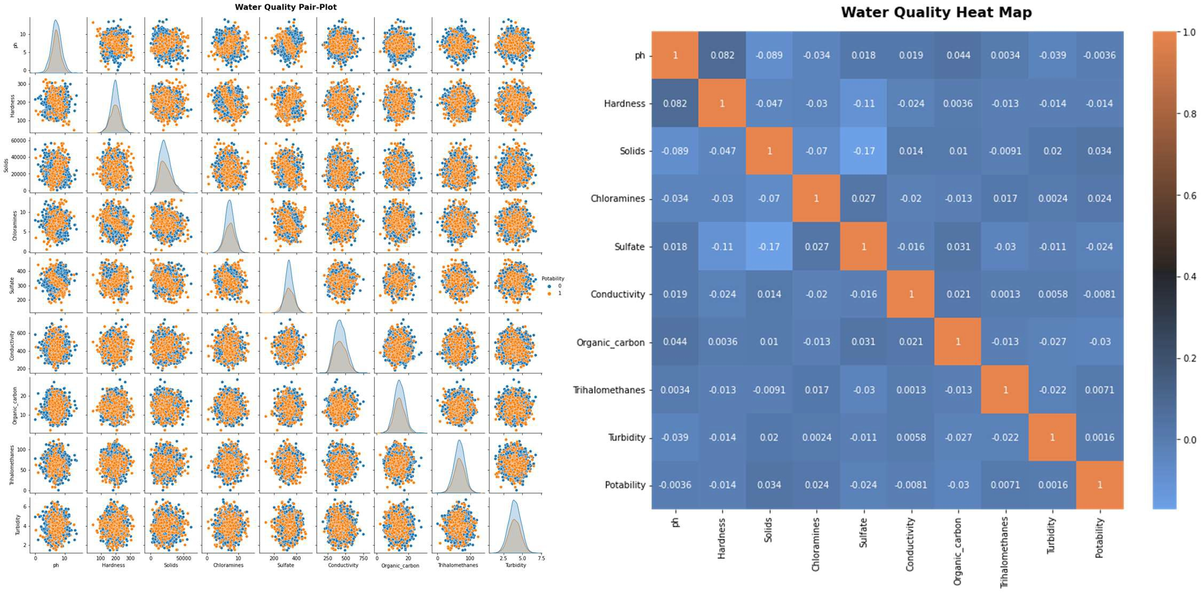
EDA: Visual Analyses

Slide 8
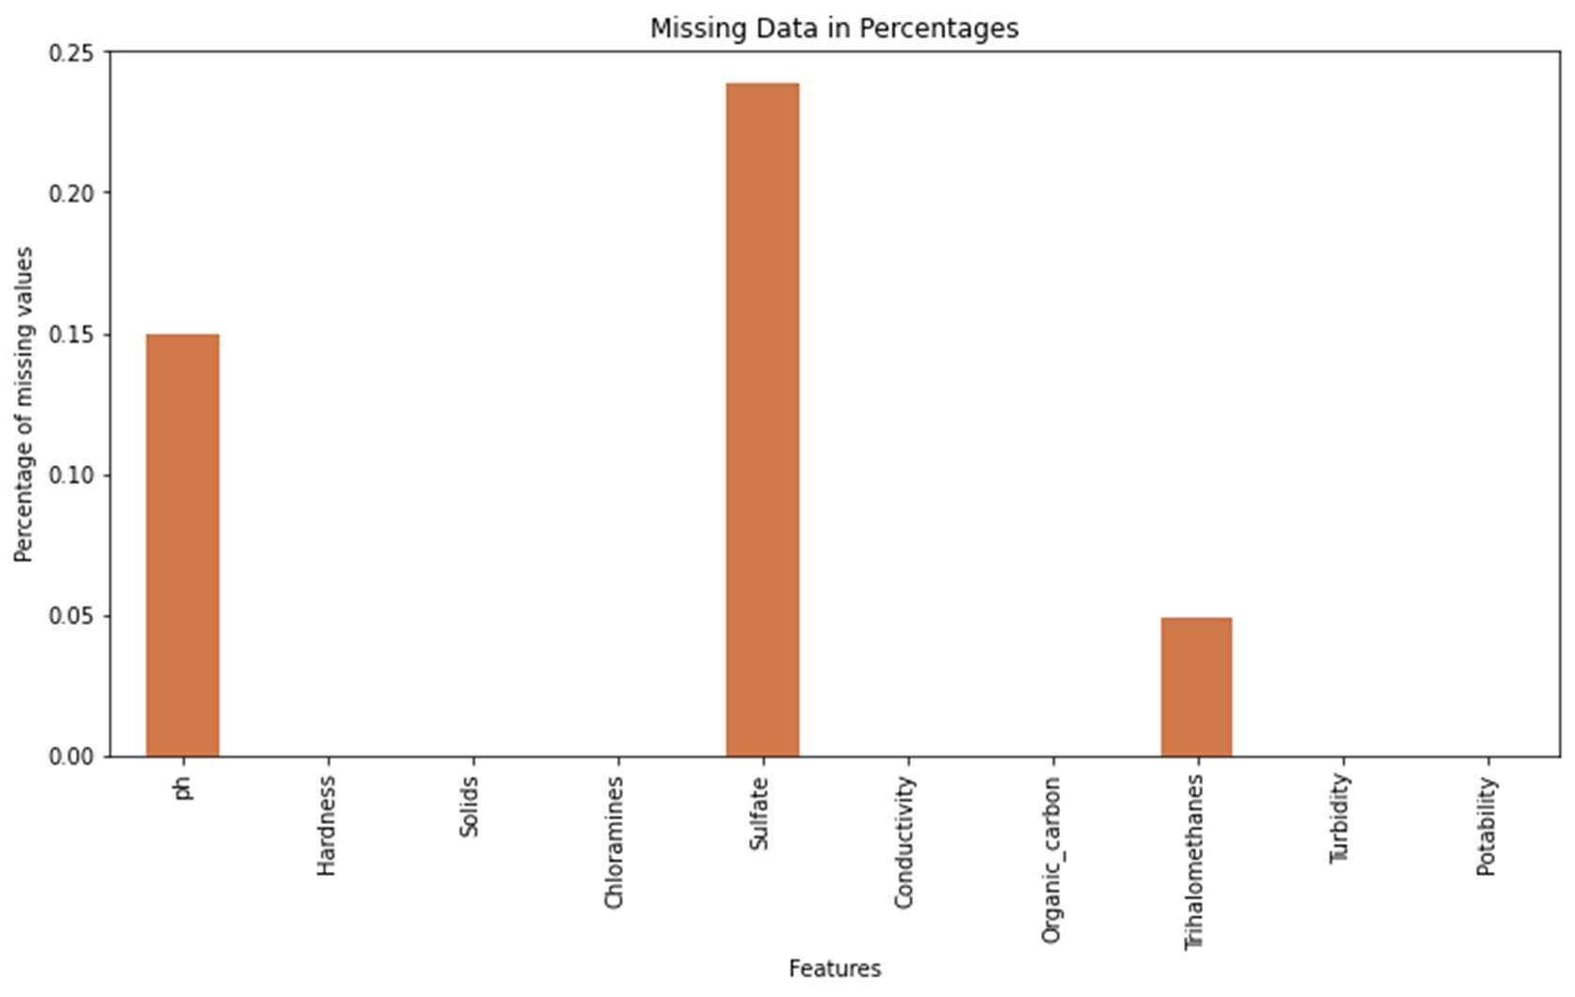
Missing Values
The majority of the parameters have a Gaussian distribution therefore it was safe to replace missing values with the mean value

Slide 9
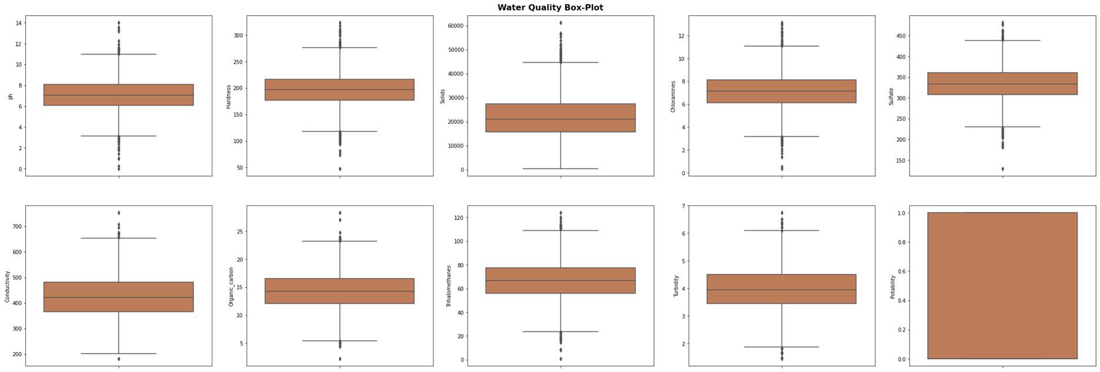

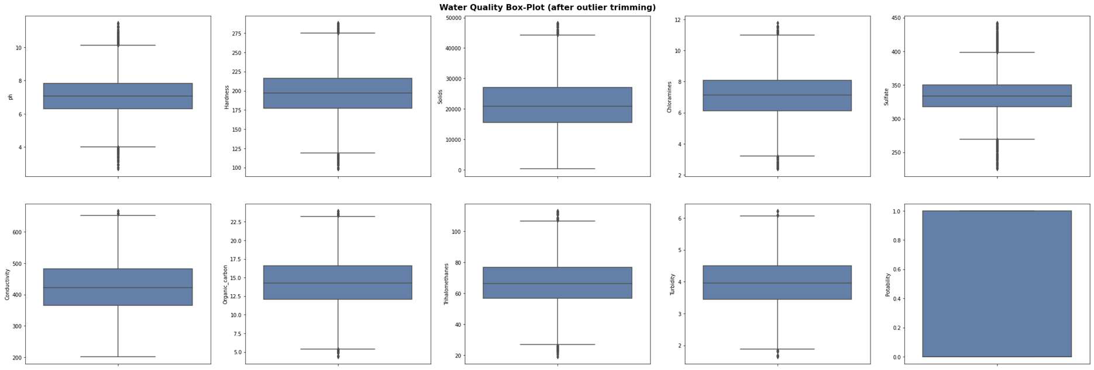
Outlier Detection

Slide 10
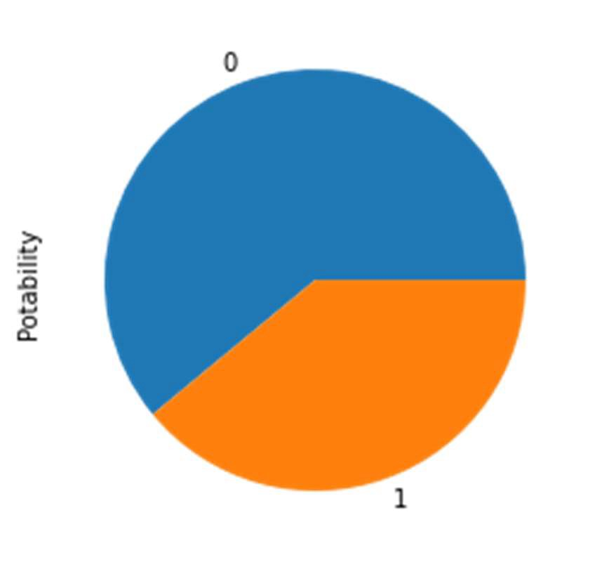
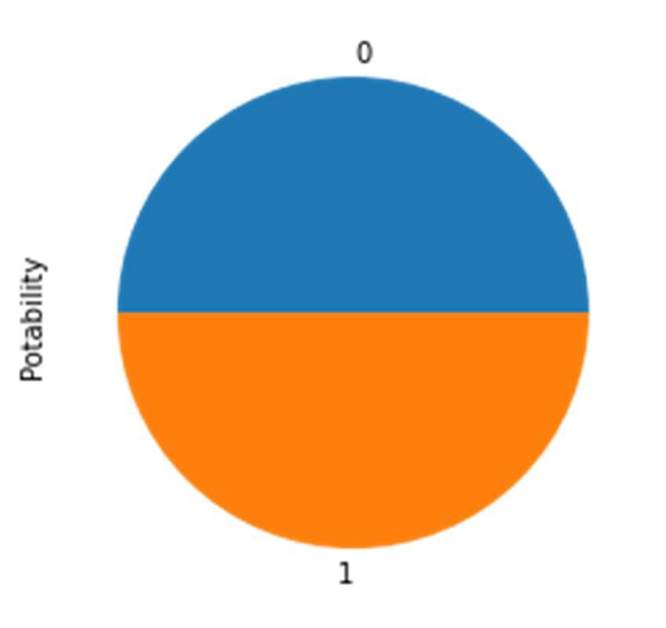

Class Imbalance
61.7%
50%
38.3%
50%
1930/1198
1930/1930
Up-sampling the minority class to balance the data for training to prevent bias to the majority class

Slide 11
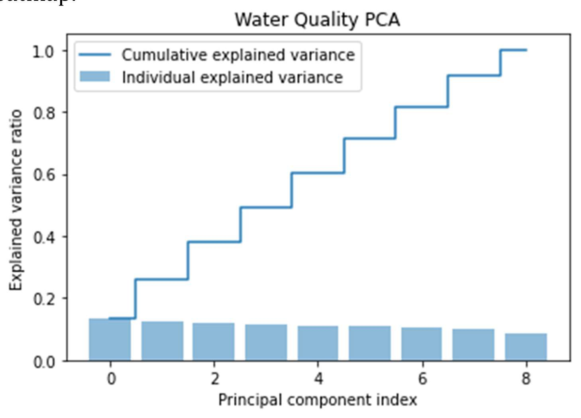
Principle Component Analysis
Exploring dimensionality reduction using PCA tells us that all the variables are independent from each other and further confirms our previous observations from the heatmap.

Slide 12
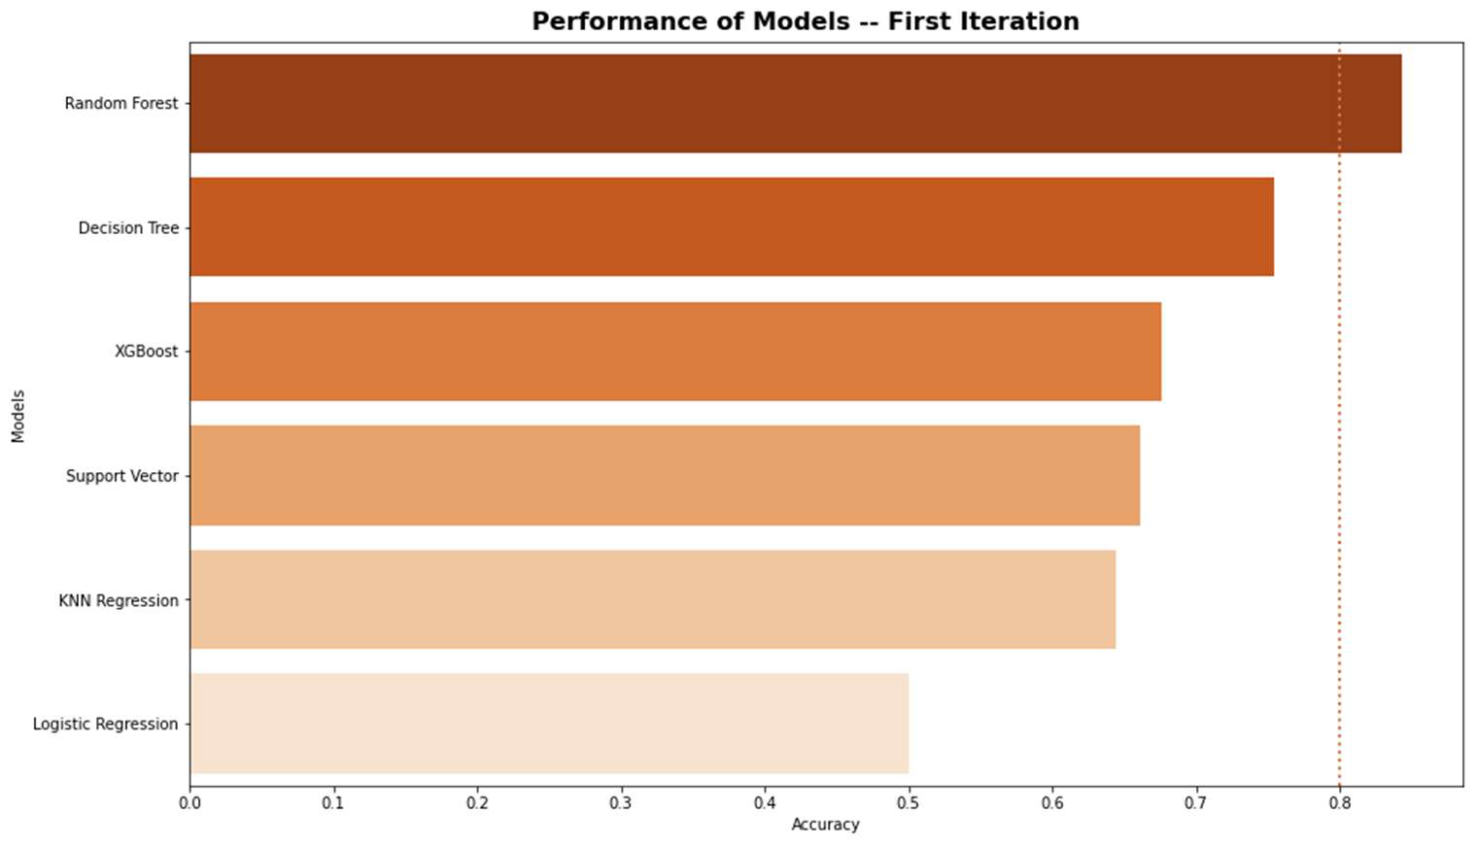
Algorithm Comparison 1st Iteration
Model |  | Accuracy | Precision | Recall | F1 Score
3 | Random Forest | 0.843264 | 0.827676 | 0.852151 | 0.839735
2 | Decision Tree | 0.753886 | 0.698690 | 0.860215 | 0.771084
5 | XGBoost | 0.676166 | 0.654822 | 0.693548 | 0.673629
4 | Support Vector | 0.660622 | 0.632212 | 0.706989 | 0.667513
1 | KNN Regression | 0.643782 | 0.620347 | 0.672043 | 0.645161
0 | Logistic Regression | 0.500000 | 0.483645 | 0.556452 | 0.517500

Slide 13
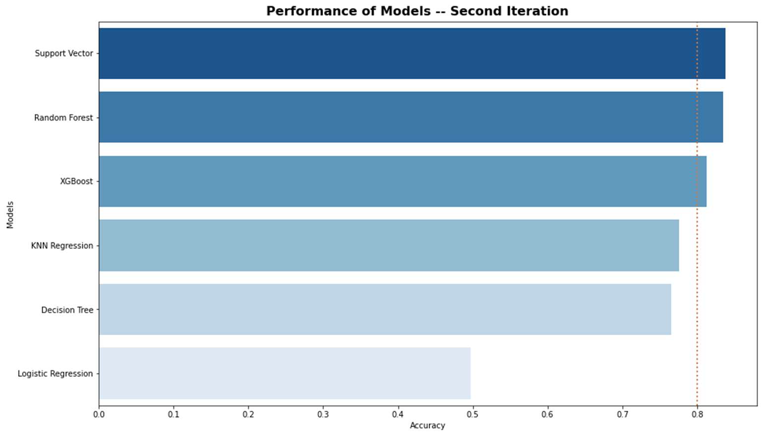
Algorithm Comparison 2nd Iteration
Model |  | Accuracy | Precision | Recall | F1 Score
4 | Support Vector | 0.838083 | 0.853868 | 0.801075 | 0.826630
3 | Random Forest | 0.834197 | 0.808081 | 0.860215 | 0.833333
5 | XGBoost | 0.812176 | 0.763341 | 0.884409 | 0.819427
1 | KNN Regression | 0.775907 | 0.722595 | 0.868280 | 0.788767
2 | Decision Tree | 0.765544 | 0.714607 | 0.854839 | 0.778458
0 | Logistic Regression | 0.497409 | 0.481132 | 0.548387 | 0.512563

Slide 14
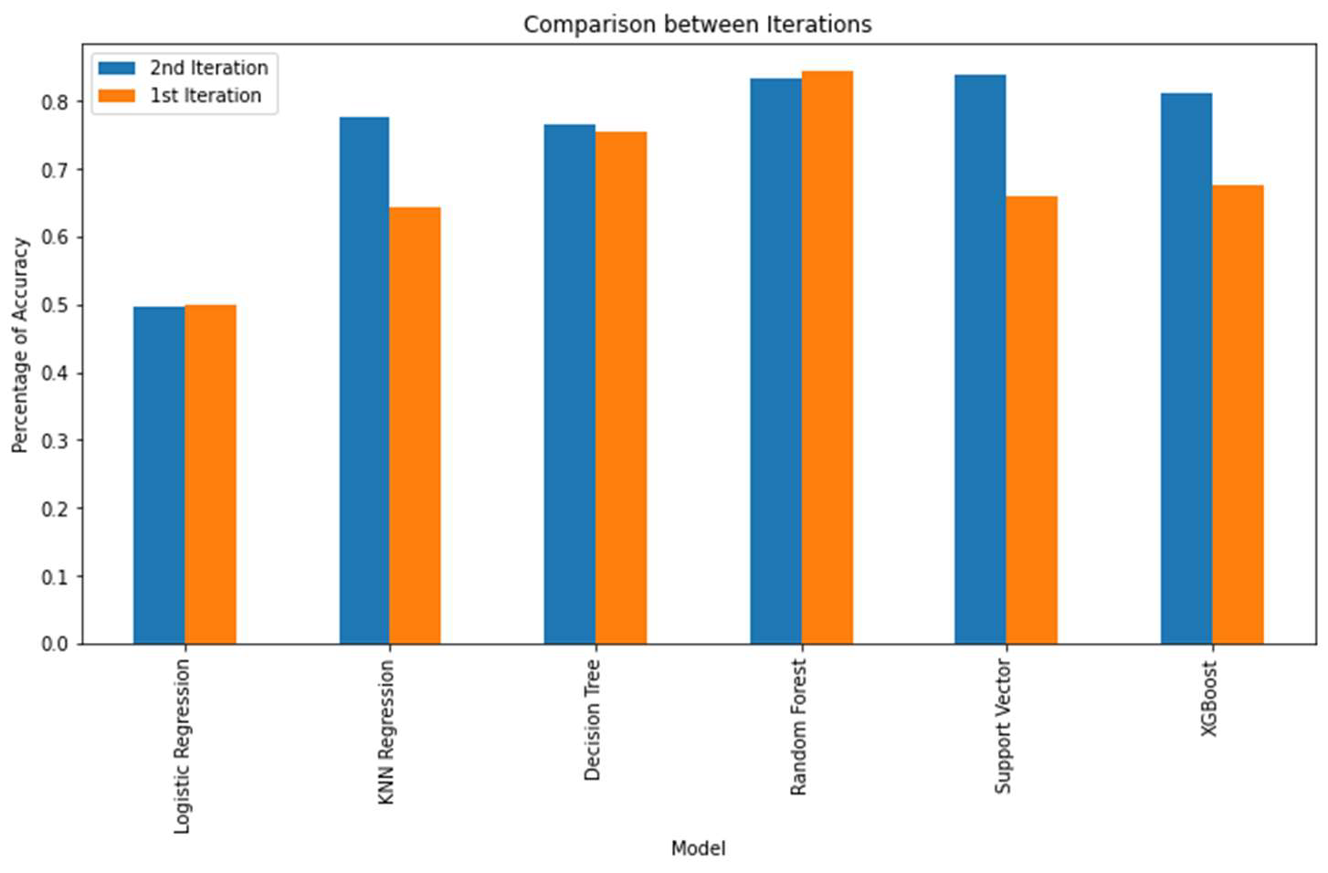
Model Evaluation
 | Model | 2nd Iteration | 1st Iteration | Difference in Accuracy
0 | Logistic Regression | 49.74% | 50.00% | -0.26%
1 | KNN Regression | 77.59% | 64.38% | 13.21%
2 | Decision Tree | 76.55% | 75.39% | 1.17%
3 | Random Forest | 83.42% | 84.33% | -0.91%
4 | Support Vector | 83.81% | 66.06% | 17.75%
5 | XGBoost | 81.22% | 67.62% | 13.60%

Slide 15
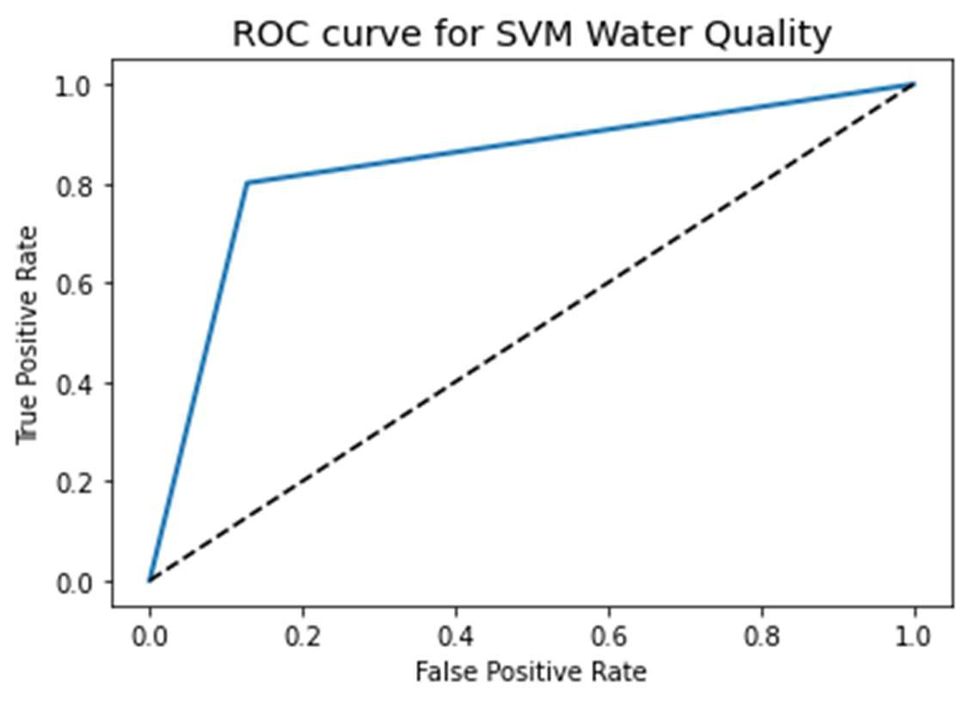
Cross Validation
K-Fold CV
Algorithm | Mean Accuracy Score | Standard Deviation
Random Forest | 85.28 % | 1.84 %
SVM | 87.98 % | 1.91 %
XGBoost | 80.73 % | 1.77%
ROC AUC: 0.8368
CV ROC AUC: 0.8674

Slide 16
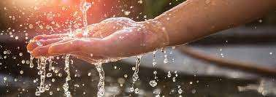
Interpretation & Recommendations
After 2nd iteration and hyper-tunning parameters, SVM performed with the greatest accuracy 84.33%
After k-Fold cross validation, SVM’s accuracy increased to 87.98%
Increasing parameters: coliforms and heavy metals
Explore deeper machine learning such as ANN (artificial neural network)

Slide 17
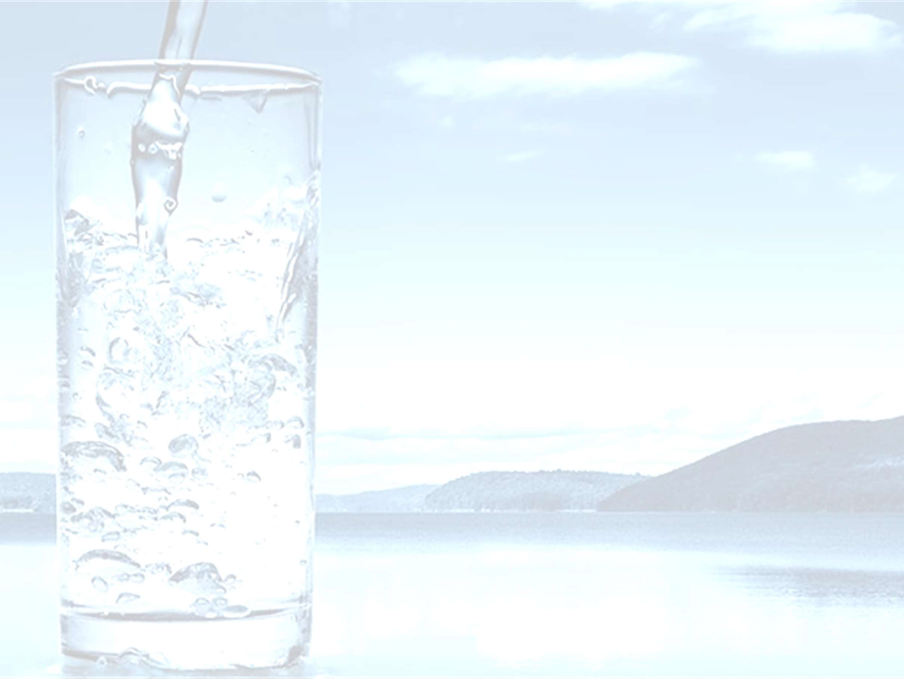
Conclusions
Can we predict water potability?
Which machine learning
Using ML it is possible to predict water potability
Support Vector Machine Classifier
algorithms can yield the most best performance 87.98% accuracy
efficient and accurate results?
Hyper-tunning did increased accuracy in modeling for most of the algorithms
The parameters within the dataset were affective in prediction although had low correlation
Through research from other studies, additional attributes such as coliform and heavy metals should be included
Confident in our findings but room
Can the parameters within the ML algorithms be tuned to yield the best results?
Are the parameters within the dataset affective in water quality prediction?
Should there be other parameters to consider?
How confident are we in our findings?
for improvement
17

Slide 18

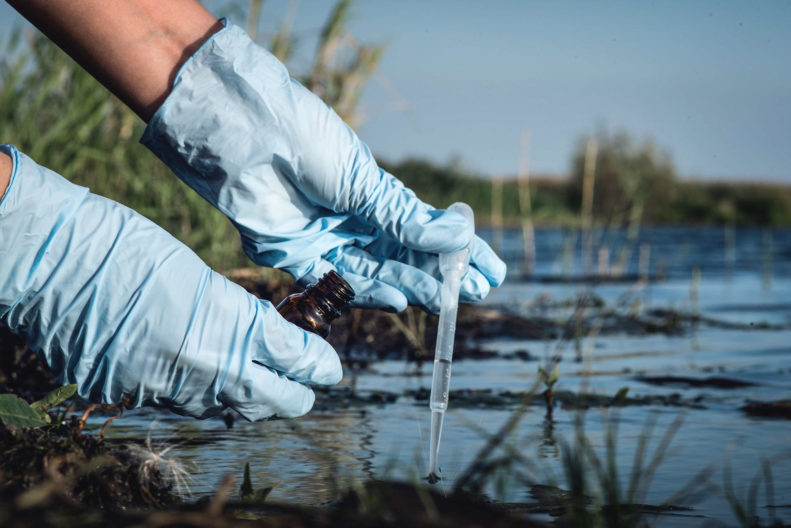
Questions?
18

